Slide 1


Technical Seminar On:
ANDROID BASED
AUTOMATED SAMRT WHEELCHAIR
Presented by:
Chikyala Sahithi
Hall ticket no: 186B1A0530
Department of computer science and engineering
Kakatiya institute of technology and science for women
Nizamabad
2018-22

Slide 2
CONTENTS
.INTRODUCTION
.TRANSMITTING SECTION
.RECEVING SECTION
.FLOW CHART
.TYPES OF WHEELCHAIRS
MECHANICAL STRUCTURE &DIMENSIONS
.HANDLING OBSTACLES & INCLINES
.ADVANTAGES
.DISADVANTAGES
.REFERENCES

Slide 3
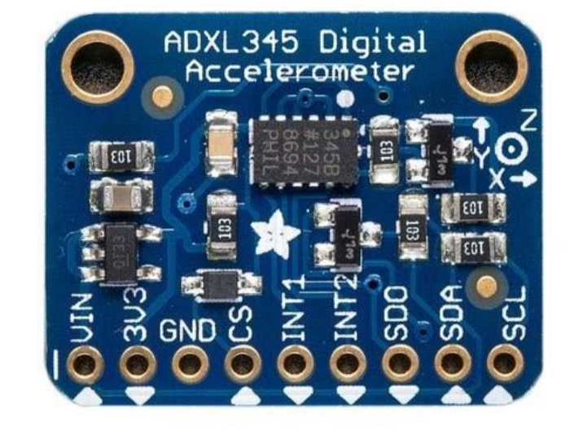
INTRODUCTION
.This paper projects an android based smart automated wheel chair for handicapped /elderly people to help them.
.It uses android based smart phones which have inbuilt axis accelerometer
sensors and Bluetooth wireless technology.
.This wheel chair is battery powered controlling two D.C motors. the chair functions depends on the accelerometer sensor in built in modern day smartphones.
. Tilt of the smartphone is given as an input command to the microcontroller via Bluetooth module the movement of the D.C motors.
ACCELEROMETER
.
. Depending on t he direction of tilt of the smart phone , the microcontroller controls the wheelchair directions. also an i.r. detection system is upgraded to detect the obstacle on the path of wheel chair and make object p&llision more avoidable. thus making handicapped person independent for movement.

Slide 4
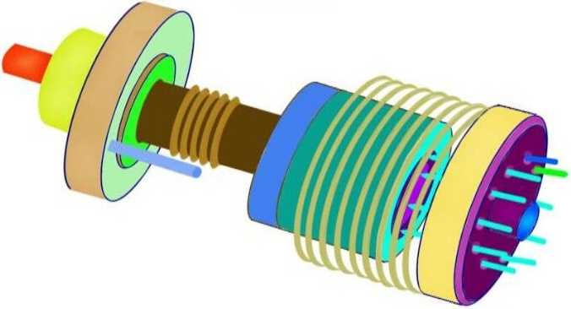
TRANSMITTING SECTION
Accelerometer- the smart phone accelerometer is a semiconductor that measures motion .
Often accelerometers is used to present landscape or portrait views of the devices screen based on the way the device is being held.
Bluetooth - Bluetooth present in the smart phone can be tapped using protocol stacks in the app design environment of the mobile operating system.
functional app- this app interfaces accelerometer to work with Bluetooth module.

Slide 5
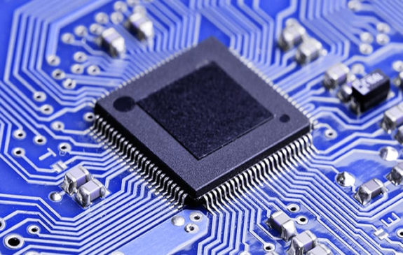
RECEIVING SECTION
• Microcontroller- its need involves the reception of data signals that are transmitted by the smart phone via Bluetooth module and control the working of device.
The wheelchair interacts with the smart phone app by means of this microcontroller via Bluetooth.-
microcontroller
. example
Tv’s microcontroller it takes the input from a remote control and delivers its
output on the screen.

Slide 6




FLOW CHART
TRANSMITER
(SMAT
PHONE)
RECEIVER
(WHEELCHAIR)
MOTOR
DRIVER
DC MOTOR
BLUETOOTH, ANDROID AND ACCELEROMETER
INSTALLED WITH
MICROCONTROLLER
and MOTOR CONTROL

Slide 7

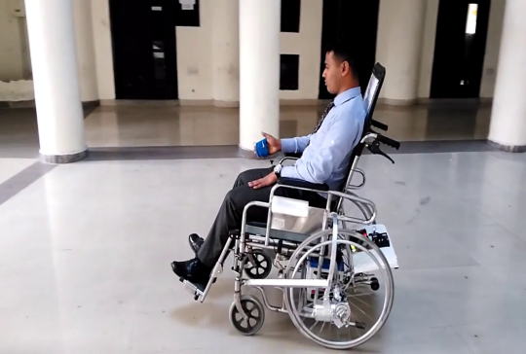
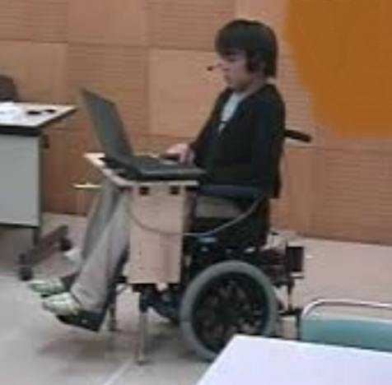
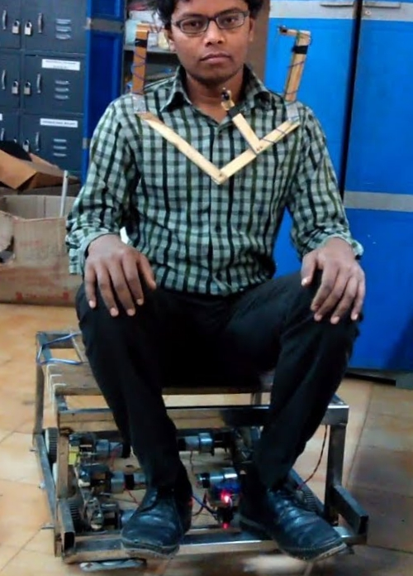
TYPES OF SMART WHEELCHAIRS:
. HAND GESTURE CONTROLLED WHEELCHAIR
.EYE CONTROLLED WHEELCHAIR.
.VOICE BASED CONTROLLED WHEELCHAIR.
.HEAD MOTION CONTROLLED WHEELCHAIR.

Slide 8
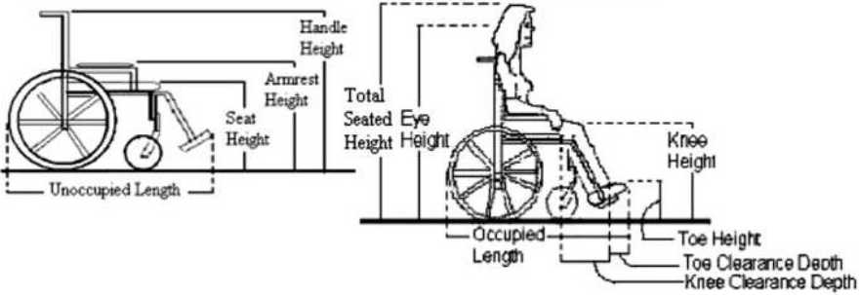
MECHANICAL STRUCTURE AND DIMENSIONS
The following figure illustrates the importance wheelchair
terminologies that needs to be considered while designing a
figure: unoccupied wheelchair figure: occupied wheelchair
Standared Dimensions:
(all measurements are in millimeters)
.unoccupied width=650-720
.unoccupied length=1000-1100
.handle height=910-950
.armrest height=700-740
seat height=700-740
combinedknee+toe clearance depth=400-450

Slide 9
handling obstacles &
INCLINES
Front-wheel drives are optimal for traversing obstacles such as curbs, grass, gravel, uneven terrain and snow. this is because the 14-inch drive wheels are the first wheels to encounter obstacles and they pull the rest of the wheelchair over them.
A rear-wheel drive means the drive wheels are pushing the front casters over obstacles. because pushing is harder than pulling, rear-wheel drives aren’t quite as efficient going over obstacles as front-wheel drives.
. Infrared radiation sensor(IR)- the device that measures and detects infrared radiation in its surroundings
when object comes close to sensor the infrared light from led goes on object and detected by recevier.

Slide 10
PROBLEMS ?
wheel chair stability is an issue in motorised wheelchairs . this issue creates a problem in handling?
cost effective wheelchair is an issue?
SOLUTIONS
.The vertical caster stem of the freewheels in the rear end reduce the stability related issues of the wheelchair.
. Reduced cost of the wheelchair as only Bluetooth is used for communicating between the devices rather than a virtual ciruit. thus the cost
of additional electrical circuitory and mechanical gear assembly is reduced.

Slide 11
ADVANTAGES
Less expensive then the conventional automatic wheel chairs.
Obstacle detection using IR sensors.
Front wheel drive provides high maneuverability
Straight stem in caster help aids in smooth operation .

Slide 12
DISADVANTAGES
• Requires smart phone for operation as a accelerometer is the main device over which the main system is dependent.
Battery recharging is needed so smart phone battery and battery to drive the motor have to periodically recharge and maintained.

Slide 13
CONCLUSION
The vertical caster stem of the freewheels in the rare end reduce the stability
related issues of the wheelchair
Controlling issue is handled through the use of I.R sensors which improve control and handling.
Manuverability and handling of the wheelchair system is improved by choosing the front wheel as motor drives.
Reduced cost of the wheelchair as only Bluetooth is used for communicating between the devices rather than a virtual circuit. thus the cost of additional electrical circuitory and mechanical gear assembly is reduced.
Two 12 volts 3.5 amp batteries were used instead of direct current supply but due to overcharging of the batteries the circuits were burnt as the discharging rate of the batteries were 4.5 amp and this led to failure . therefore use of 12 volts ,3.5 amp dc batteries is restricted until the problem of overcharging is solved.

Slide 14
REFERENE
・ Based on the research paper “smartphone accelerometer controlled
. Automated wheelchair” by Vigneshwar. Santhanam and Vignesh. Viswanathan
httd://psrcenfre.orq/imaaes/extraimaaes/icecebe%20113824.pdf
• . . . .. www.darthshaa
• mirley.firlej.org
•junweihuang.io
•nextsepian.com

Slide 15
THANK YOU

